Slide 1
Discovering latent topical phrases in document collections and networks with text components: Leveraging text mining and information network analysis for human oriented applications
DEFENSE PRESENTATION
Marina Danilevsky
PhD Candidate, Dept of Computer Science
University of Illinois, Urbana-Champaign

Slide 2
Yes, But What’s It Really All About, Then, When You Get Right Down To It, I Mean Really!
Didactylos the Ephebian
Let thy speech be short, comprehending much in few words.
Ecclesiasticus 32:8

Slide 3
The topic of topic representation
Topic discovery approaches are unigram centric, and are not optimizied for representing a topic well to human judgement
We present a framework to construct topical phrases
Topic representation should be robust to different data sets, and should be useful in real world settings
We demonstrate the effectiveness of our framework on different datasets, and evaluate both topical phrase quality and task success
Topic representation should be able to discover topics of different granularities, and incoprorate information present in network data
We present a framework to construct a topical hierarchy, whether from text or from a network of text and other entities

Slide 4
Constructing Topical Phrases
Data
collection of short texts in scientific domain
Topic Discovery
unigram-generating
topic model (bLDA)
Topical Phrase Construction
frequent pattern mining and integrated ranking
Evaluation
topical phrase
qualty

Slide 5
New Domain New Dataset New Evaluation
Data
collection of longer texts in general domain
Topic Discovery
unigram-generating
topic model (LLDA)
Topical Phrase Construction
frequent pattern mining and integrated ranking
Evaluation
topical phrase qualty and classification task sucess

Slide 6
Constructing
A Topical Hierarchy
Data
network data with
short text component
and other entites
Topic Discovery
clustering
co-occurrence network
Topical Phrase Construction
estimated topical frequency and integrated ranking
Evaluation
topical hierarchy
quality and subtopic discovery

Slide 7
Constructing Topical Phrases
Data
collection of short texts in scientific domain
Topic Discovery
unigram-generating
topic model (bLDA)
Topical Phrase Construction
frequent pattern mining and integrated ranking
KERT
Evaluation
topical phrase
qualty

Slide 8
How to represent a topic?
learning
reinforcement
support
machine
vector
selection
feature
random
fields
classification
conditional
trees
decision
:
learning
support vector machines
reinforcement learning
feature selection
conditional random fields
classification
decision trees
:
versus
The topic that represents the area of Machine Learning
Notes:
should be able to do this automatically

Slide 9
How to represent a topic?
As an integrated ranked list of mixed-length phrases
learning
support vector machines
reinforcement learning
feature selection
conditional random fields
classification
decision trees
:
Comparability property: a phrase ranking function should be able to directly compare phrases of mixed lengths
The topic that represents the area of Machine Learning
Notes:
should NOT have to give me separate lists of unigrams, bigrams, trigrams, etc. Oh, and it shouldn’t take forever to run either - but I’ll return to this point.

Slide 10
Topical Keyphrase Extraction & Ranking
…
knowledge discovery using least squares support vector machine classifiers
support vectors for reinforcement learning
a hybrid approach to feature selection
pseudo conditional random fields
automatic web page classification in a dynamic and hierarchical way
inverse time dependency in convex regularized learning
postprocessing decision trees to extract actionable knowledge
variance minimization least squares support vector machines
a framework for semi-supervised learning based on clustering criteria
…
learning
support vector machines
reinforcement learning
feature selection
conditional random fields
classification
decision trees
:
Topical phrase
extraction and ranking
Unigram topic assignment: Topic 1 & Topic 2

Slide 11
KERT Framework
Use a unigram-generating topical modeling approach to cluster words into T topics
E.g., we will use background LDA (bLDA) to cluster unigrams into T topics, and 1 background topic
Extract topical keyphrases for each topic according to the unigram topic assignment
Rank the keyphrases in each topic

Slide 12
Extracting Topical Keyphrases
For collections of content-representative short documents, it’s beneficial to define a phrase to be order-free and non-consecutive
two CS paper titles, one containing ‘mining frequent patterns’ and the other containing ‘frequent pattern mining’ are clearly discussing the same topic
‘mining top-k frequent closed patterns’ also belongs to the topic of frequent pattern mining, in addition to incorporating secondary topics of top-k frequent patterns, and closed patterns.

Slide 13
Extracting Topical Keyphrases
For each topic t:
construct a topic-t word set consisting of the words with the topic label t for each document
combine these into a collection D_{t}
mine frequent word sets from D_{t} using any efficient pattern mining algorithm, such as FP-growth
topical keyphrase for topic t: a set of words p = {w₁ ...w_{n}} simultaneously labeled with topic t in at least μ documents (f_{t}(p) >μ)
Notes:
we are throwing away the original documents

Slide 14
Comparability Property
Now, KERT can directly compare and rank phrases of any length
Extracting the topical keyphrases allows us to represent the random event e_{t}(p) = ‘seeing a phrase p in a random document with topic t.’

Slide 15
Phrase Ranking: Four Criteria
Coverage
Purity
Phraseness
Completeness

Slide 16
Coverage
A representative keyphrase for a topic should cover many documents within that topic.
‘information retrieval’ has better coverage than ‘cross-language information retrieval’ for IR topic.
Directly quantify this measure as the probability of seeing a phrase in a document with a given topic.
Notes:
denominator is the number of docs that have a topic-t phrase

Slide 17
Purity
A phrase is pure in topic t if it is only frequent in documents about topic t and not frequent in documents about other topics.
‘query processing’ is a more pure phrase than ‘query’ in the DB topic.
Compare the probability of seeing a phrase in the topic-t collection of documents with the probability of seeing it in any other mixed-topic collection.

Slide 18
Phraseness
A group of words should be grouped into a phrase if they co-occur significantly more frequent than the expected co-occurrence frequency given that each word in the phrase occurs independently.
’active learning’ is a good quality phrase in the Machine Learning topic, but ‘learning classification’ is not, since the latter two words co-occur only because both are popular in the topic.
Compare the probability of seeing a phrase P = {w₁…w_{n}} and seeing the n words independently

Slide 19
Completeness
A phrase p is not complete if a longer phrase p’ which contains p usually co-occurs with p.
‘vector machines’ is not a complete phrase, but ‘support vector machines’ is, because ’support’ almost always accompanies ‘vector machines’
Examine the conditional probability of observing P’ given P in a topic-t document (will use as filter)

Slide 20
Unified Ranking Function
Can interpret function as a weighted summation of two pointwise KL-divergence metrics
Coverage is the most important since when coverage (frequency) as small, all other metrics are unreliable
Notes:
The combination of Phraseness and Completeness take the place of other NLP criteria that have been used by approaches which perform phrase extraction rather than phrase construction, such as part-of-speech tagging (e.g. is the phrase a noun group?]) or suffix sequences.
The Phraseness and Completeteness ranking criteria together embody the characteristic of a phrase being ‘understandable’ to people or having ‘term cohesion’.
We also do not go the route of evaluating this characteristic by calculating semantic relatedness between words, which has been used in other approaches using knowledge bases such as Wikipedia. This is because we wish to avoid relying on external information which may possibly be unavailable, or not relevant for a particular dataset, for instance if the dataset is domain-specific.

Slide 21
Unified Ranking Function
γ = threshold for pruning incomplete phrases
γ = 1 ➔ ignore the criteria, retain all closed phrases
γ = 0 ➔ retain only maximal phrases (longest possible)

Slide 22
Unified Ranking Function
ω = tradeoff between purity and phraseness
as ω increases, we expect more topic-independent but common phrases to be ranked higher

Slide 23
Machine Learning: Top Phrases
Dataset: DBLP paper titles. KERT variations ignore each ranking criterion in turn.
Notes:
Removing coverage from our ranking function yields the worst results, confirming the intuition that a high quality keyphrase must at minimum have good coverage.
Without purity, the function favors bigrams and trigrams that all seem to be meaningful, although several high quality unigrams such as ‘learning’ and ‘classification’ no longer appear.
Removing phraseness, in contrast, yields meaningful unigrams but very few bigrams.
Finally, without completeness, phrases such as ‘support vector’ and ‘vector machines’ are improperly highly ranked, as both are sub-phrases of the high quality trigram ‘support vector machines.’

Slide 24
Experiment: User Study
DBLP Dataset: collection of CS paper titles.
Topics found: Databases, Data Mining, Information Retrieval & Machine Learning.
For each topic:
retrieve the top 20 ranked keyphrases by each method.
Gather these keyphrases and present in random order.
Ask users (9 CS grad students) to evaluate the quality of each keyphrase on a 5 point Likert scale.
Methods for comparison:
baselines: kpRel and kpRelInt, developed for topical keyphrase extraction in microblogs¹
variations of KERT where the keyphrase extraction steps are identical, but each of the four ranking criteria is ignored in turn:

Slide 25
User Study Results
nKQM = normalized keyphrase quality measure for top-K phrases
KERT_{–pur} performs the best - which may reflect human bias towards longer phrases - showing an improvement of at least 50% over the kpRelInt* baseline
Notes:
As expected, KERT–cov exhibits the worst performance. The baselines perform slightly better, and it is interesting to note that kpRel, which is smoothed purity, performs better than kpRelInt*, and even slightly better than KERT–phr.
kpRelInt* adds in a measure of overall keyphrase coverage in the entire collection, which hurts rather than helps for this task. Removing completeness appears to have a very small negative effect, and we hypothesize this is be- cause high-ranked incomplete keyphrases are relatively rare, though very obvious when they do occur (e.g. ‘vector machines’). KERT–pur performs the best - which may reflect human bias towards longer phrases - with an improvement of at least 50% over the kpRelInt* baseline for all reported values of K.
Although we cannot directly evaluate which differences between the nKQM val- ues are statistically significant, we examined the differences between the distributions of mean judge scores. We found, for example, that the preference for phrases generated by KERT–pur was statistically significant, whereas the difference between KERT and KERT-com was not.

Slide 26
Scalability of KERT
Compare with phrase-generating approaches: Turbo Topics & PDLDA
Datasets:
DBLP_{full} = snapshot of all paper titles in DBLP
DBLP = 33,313 paper titles from DBLP
arXiv = 9,722 paper titles from arXiv
ACL_{title} = 13,638 paper titles from ACL Anthology Network

Slide 27
Data
collection of short texts in scientific domain
Topic Discovery
unigram-generating
topic model (bLDA)
Topical Phrase Construction
frequent pattern mining and integrated ranking
Evaluation
topical phrase
qualty

Slide 28
New Domain New Dataset New Evaluation
Data
collection of (labeled) longer texts in general domain
Topic Discovery
unigram-generating
topic model (LLDA)
Topical Phrase Construction
frequent pattern mining and integrated ranking
KERT
Evaluation
topical phrase qualty and classification task sucess
Notes:
So far have done:
KERT on short text – haven’t done longer text
KERT on scientific domain, where the text is pretty well structured and has well-established vocabulary. Haven’t done just plain english
Want to apply KERT to a real task and see how it performs

Slide 29
Goodreads
Goodreads is a ‘social cataloguing’ website
A database of books, and member reviews of the books
Books are also labeled by members as belonging to genres
Book descriptions are created and maintained by Librarians – Goodreads members with an established track record

Slide 30
Genre Labels
Anyone can label a book as belonging to a genre
though, only Librarians can create a genre
Some books may be labeled with MANY genres
this is also more likely if the book is popular
e.g.: Harry Potter and the Half-Blood Prince, the 6th Harry Potter book, had at least 100 people label it with each of the following genres:
mystery
childrens
romance
fantasy
science-fiction
adventure
fiction
paranormal
teen
literature
magic
school
supernatural
contemporary
science-fiction-fantasy
novels
urban-fantasy
classics
young-adult
Notes:
these genres are fuzzy, they overlap, and genre labeling in general is a subjective task. But a book labeled with multiple genres means that there are signals there in the description related to all those genres. This directly leads us to how to adapt KERT to work with this data

Slide 31
Adapting Kert for Goodreads data
thriller
Mining & Ranking
FBI Agent Alex Cross is on vacation with his family in Disneyland when he gets a call from the Director. A well-known actress was shot outside her home in Beverly Hills.
fbi agent alex cross
vacation
family
disneyland
call
director
well know actress
:
alex cross
serial killer
jack reacher
dean koontz
medical examiner
mitch rapp :
Labeled LDA
fbi 1
agent 1
alex 2
cross 2
vacation 0
family 3
disneyland 1
call 0
directory 2
:
thriller
fbi agent alex cross vacation family disneyland call director well know actress shot outside home beverly hills

Slide 32
Evaluating topical phrases for book genres
Study 1: Genre Characterization
Is the generated set of topical phrases a good description of this genre?
This somewhat mimics the previous study, though now the group of topical phrases as a whole is judged
Study 2: Book Characterization
Can the generated set of topical phrases be used to correctly identify the genre of a book from the book description?
This is a new metric, centered around a classification task
Notes:
a genre is by definition subjective
Isaac Asimov connotes sci-fi for example

Slide 33
Goodreads dataset
Take books that got labeled by at least 100 members as belonging to a genre
For each book, pull the title, author, description, and all the genres it’s been labeled with (at least 100 members picked each genre)
Keep only book descriptions in english
Dataset: 24,060 book descriptions
Remove function words, stem and lemmatize using python nltk library
End up with average of 67 unigrams per description
order of magnitude bigger than collection of DBLP titles
Notes:
compare to how long the titles were – this was 10 times longer

Slide 34
Three Experiments
Humor
Philosophy
458
1
314
Each experiment models subset of books labeled with one or more of three selected genres
0
1
1
458
1,235 books
Thriller
Children’s
Young Adult
History
Religion
324
272
2520
785
12
102
0
6
0
55
25
29
3,384 books
213
272
1,231 books
New Adult
Philosophy
Notes:
Consider just the subset of books that were labeled with at least one of the genres
explain the semantic relationships that are, or are not present
doing three genres each time lets us set the parameters and leave them alone. We did minsup of 10 (1% roughly), completeness at 0.9, phraseness at 0.2, though it didn’t make a very large difference at the very top

Slide 35
Scalability
 | Humor Philosophy Thriller | Children’s Young Adult New Adult | History Philosophy Religion
# books | 1,235 | 3,384 | 1,231
kert | 10m 16.693s | 22m 28.95s | 10m 35.399s
kert llda | 9m15.415s | 22m 26.659s | 10m 35.347s
kert mine & rank | 1.278s | 2.291s | 1.052s
pdlda | 2m 36.014s | 4m 50.493 | 3m 15.802s
turbo topics | 20m 9.87s | 5hr 54m 49.803s | 52m 2.598s
tt lda | 4m 14.727s | 9m18.844s | 4m 37.015s
tt topics | 15m 55.143s | 5 hr 45m 30.959s | 47m 25.583s

Slide 36
Example Experiment: Humor, Thriller, Philosophy
Humor
Thriller
Philosophy
stephanie plum bounty hunter
joe morelli
ankh morpork
dave barry
comic strip
bertie wooster
alex cross
serial killer
jack reacher
dean koontz
medical examiner
mitch rapp
twentieth century
ayn rand
human nature
philosophy
work
thought
KERT
life
serial killer
popular comic strip
work
human nature
oliver wendell holmes
life
united states
john stuart mill
find
san francisco
secret service agent
life
young woman
world war ii
find
jack reacher
boston medical examiner
PDLDA
TurboTopics
world
man
life
time
make
love
year
murder
secret
day
death
call
work
life
reader
human
philosophy
story

Slide 37
Study 1: Genre Characterization
How well does each set of topical phrases describe the given genre?
stephanie plum bounty hunter
joe morelli
ankh morpork
dave barry
comic strip
bertie wooster
alex cross
serial killer
jack reacher
dean koontz
medical examiner
mitch rapp
twentieth century
ayn rand
human nature
philosophy
work
thought
life
serial killer
popular comic strip
work
human nature
oliver wendell holmes
life
united states
john stuart mill
find
san francisco
secret service agent
life
young woman
world war ii
find
jack reacher
boston medical examiner
Thriller
world
man
life
time
make
love
year
murder
secret
day
death
call
work
life
reader
human
philosophy
story
3 experiments * 9 topical phrase groups * 3 genres * 20 people per genre = 1,620 data points
Notes:
add in likert scale 1-5 along with labels

Slide 38
Measuring algorithm overall accuracy
topical phrases
Humor
Thriller
Philosophy
correct genre
Humor
vs
Thriller
Philosophy
Want scores > 3 for:
humor topical phrases describing a humor genre or book
thriller topical phrases describing a thriller genre or book
etc.
Want scores <= 3 for:
humor topical phrases describing a thriller or philosophy genre or book
etc.

Slide 39
Genre Characterization: Overall Accuracy
correct vs incorrect | Humor Philosophy Thriller | Children’s Young Adult New Adult | History Philosophy Religion
kert | 4.33 > 2.10 §§ | 3.85 > 2.84 §§ | 4.28 > 2.43 §§
pdlda | 2.65 ≈ 2.49 | 3.68 > 3.22 ** | 2.82 ≈ 2.62
turbotopics | 3.77 > 2.27 §§ | 3.55 > 3.20 ** | 3.37 > 2.84 ***
Wilcoxon rank sum * p< 0.1 ** p < 0.05 *** p < 0.01 § p < 0.001 §§ p < 0.0001
Mean of scores for “correct” match of topical phrase group and genre
e.g., humor topical phrases describing a humor genre
mean should be > 3 on 5 pt Likert scale (good, or really good characterization)
Mean of scores for “incorrect” match of topical phrase group and genre
e.g., humor topical phrases describing a thriller or philosophy genre
mean should be <= 3 on 5 pt Likert scale (neutral, bad, or really bad characterization)

Slide 40
Genre Characterization: Pairwise Accuracy
 | Humor | Philosophy | Thriller
kert vs pdlda | 4.00 > 2.45 *** | 4.70 > 2.40 § | 4.30 > 3.10 ***
kert vs tt | 4.00 > 2.55 § | 4.70 ≈ 4.50 | 4.30 ≈ 4.25
pdlda vs tt | 2.45 ≈ 2.55 | 2.40 < 4.50 § | 3.10 < 4.25 ***
 | Children’s | Young Adult | New Adult
kert vs pdlda | 4.25 > 3.55 ** | 3.60 ≈ 3.90 | 3.70 ≈ 3.60
kert vs tt | 4.25 ≈ 4.00 | 3.60 ≈ 3.40 | 3.70 ≈ 3.25
pdlda vs tt | 3.55 < 4.00 * | 3.90 ≈ 3.40 | 3.60 ≈ 3.25
 | History | Philosophy | Religion
kert vs pdlda | 3.60 < 4.10 * | 4.65 > 2.15 § | 4.60 > 2.20 §
kert vs tt | 3.60 ≈ 3.80 | 4.65 > 3.80 *** | 4.60 > 2.50 §
pdlda vs tt | 4.10 ≈ 3.80 | 2.15 < 3.80 *** | 2.20 ≈ 2.50
Wilcoxon rank sum * p< 0.1 ** p < 0.05 *** p < 0.01 § p < 0.001 §§ p < 0.0001
Notes:
can mention pdlda’s one win as “a stopped clock is right twice a day” so if all 3 descriptions fit History, then it’s good for History and bad for the others, so it’s not good at differentiating topics.

Slide 41
Study 2: Book Characterization
How well does each set of topical phrases describe the given book?
Mary, Mary
by James Patterson
FBI Agent Alex Cross is on vacation with his family in Disneyland when he gets a call from the Director. A well-known actress was shot outside her home in Beverly Hills. Shortly afterward, an editor for the Los Angeles Times receives an e-mail describing the murder in vivid details. Alex quickly learns that this is not an isolated incident. The killer, known as Mary Smith, has done this before and plans to kill again.
Right from the beginning, this case is like nothing Alex has ever been confronted with before. Is this the plan of an obsessed fan or a spurned actor, or is it part of something much more frightening? Now members of Hollywood's A-list fear they're next on Mary's list, and the case grows by blockbuster proportions as the LAPD and FBI scramble to find a pattern before Mary can send one more chilling update.
stephanie plum bounty hunter
joe morelli
ankh morpork
dave barry
comic strip
bertie wooster
alex cross
serial killer
jack reacher
dean koontz
medical examiner
mitch rapp
twentieth century
ayn rand
human nature
philosophy
work
thought
life
serial killer
popular comic strip
work
human nature
oliver wendell holmes
life
united states
john stuart mill
find
san francisco
secret service agent
life
young woman
world war ii
find
jack reacher
boston medical examiner
world
man
life
time
make
love
year
murder
secret
day
death
call
work
life
reader
human
philosophy
story
3 experiments * 9 topical phrase groups * 3 genres * 5 books per genre * 10 people per book = 4,050 data points
Notes:
add in likert scale

Slide 42
Book Characterization: Overall Accuracy
correct vs incorrect | Humor Philosophy Thriller | Children’s Young Adult New Adult | History Philosophy Religion
kert | 3.53 > 2.09 §§ | 3.93 > 1.87 §§ | 3.99 > 1.88 §§
pdlda | 2.50 ≈ 2.42 | 2.11 > 2.28 ** | 2.05 ≈ 2.04
turbotopics | 3.11 > 2.42 §§ | 3.33 > 3.00 ** | 3.30 > 2.75 §§
Wilcoxon rank sum * p< 0.1 ** p < 0.05 *** p < 0.01 § p < 0.001 §§ p < 0.0001
Mean of scores for “correct” match of topical phrase group and book’s genre
e.g., humor topical phrases describing a humor book
mean should be > 3 on 5 pt Likert scale (good, or really good characterization)
Mean of scores for “incorrect” match of topical phrase group and book’s genre
e.g., humor topical phrases describing a thriller or philosophy book
mean should be <= 3 on 5 pt Likert scale (neutral, bad, or really bad characterization)
Notes:
stress low numbers are low and that’s important, to shoot down bad labels, not just to identify good ones

Slide 43
Book Characterization: Pairwise Accuracy
 | Humor | Philosophy | Thriller
kert vs pdlda | 3.04 > 2.44 ** | 3.94 > 2.32 § | 3.60 > 2.74 §
kert vs tt | 3.04 > 2.48 * | 3.94 > 3.56 * | 3.60 ≈ 3.28
pdlda vs tt | 2.44 ≈ 2.88 | 2.32 < 3.56 § | 2.74 < 3.28 **
 | Children’s | Young Adult | New Adult
kert vs pdlda | 4.32 > 1.66 §§ | 3.90 > 2.02 §§ | 3.58 > 2.66 §
kert vs tt | 4.32 > 3.38 §§ | 3.90 > 3.28 ** | 3.58 ≈ 3.34
pdlda vs tt | 1.66 < 3.38 §§ | 2.02 < 3.28 §§ | 2.66 < 3.34 §
 | History | Philosophy | Religion
kert vs pdlda | 3.72 > 2.96 § | 4.10 > 1.64 §§ | 4.16 > 1.56 §§
kert vs tt | 3.72 ≈ 3.48 | 4.10 ≈ 3.90 | 4.16 > 2.52 §§
pdlda vs tt | 2.96 < 3.48 *** | 1.64 < 3.90 §§ | 1.56 < 2.52 §§
Wilcoxon rank sum * p< 0.1 ** p < 0.05 *** p < 0.01 § p < 0.001 §§ p < 0.0001
Notes:
this is why it’s important to do this for genres, you need context, phrases connote all this context and you can really tell the difference here vs the first task

Slide 44
Data
collection of (labeled) longer texts in general domain
Topic Discovery
unigram-generating
topic model (LLDA)
Topical Phrase Construction
frequent pattern mining and integrated ranking
Evaluation
topical phrase qualty and classification task sucess
Notes:
So far have done:
KERT on short text – haven’t done longer text
KERT on scientific domain, where the text is pretty well structured and has well-established vocabulary. Haven’t done just plain english
Want to apply KERT to a real task and see how it performs

Slide 45
Constructing A Topical Hierarchy
Data
network data with
short text component
and other entites
Topic Discovery
clustering
co-occurrence network
Topical Phrase Construction
estimated topical frequency and integrated ranking
CATHY
Evaluation
topical phrase
qualty and subtopic discovery

Slide 46
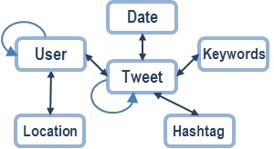
Network data – text component
Network has topics.
Text component is informative.
We are interested in discovering topics using text component
If there are non-text components (e.g. entities), at least some of them may be beneficial to analyze in a topical way
Scientific publication
News
Social media

Slide 47
Topical Hierarchy from DBLP
Venue
Terms
Paper
Authors

Slide 48
CATHY: Constructing A Topical HierarchY
End goal: hierarchy of topics and subtopics
Topic-modeling approaches can’t naturally use the output of topic modeling approaches to go down and generate a hierarchy
Alter topic discovery approach to be recursive
Output of a topic serves as input for its subtopics
Parent-child relationship of topics and subtopics
Subtopics constructed exclusively from their parent topic
Constructing 2 topics, each with 3 subtopics is not the same as 6 topics
Topic representation remains phrase-centric
Phrases of mixed lengths are mined and ranked for each discovered topic
Phrase ranking is with respect to sibling subtopics, not parent topic
Highly ranked phrases within a topic might, or might not, appear highly ranked within its subtopics

Slide 49
CATHY Framework
information retrieval
question answering
relevance feedback
web search
search engine
world wide web
semantic web
Recursive construction
Topic discovery
learning
support vector machines
reinforcement learning
feature selection
conditional random fields
classification
decision trees
Term co-occurrence network
Topical phrase mining and ranking

Slide 50
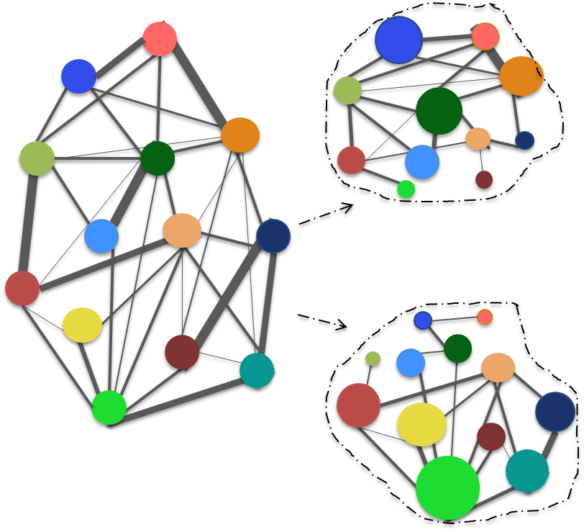
Recursive topic discovery
Every topic node t in the topical hierarchy is associated with a term co-occurrence network G^{t}
G⁰ is created from the original documents; edge weight is # co-occurrences
Given a topic t and the associated network G^{t}, discover subtopics by partitioning edge weights
….
mining association rules in hypertext databases.
efficient search for association rules.
adtrees for fast learning of association rules.
…

Slide 51
A generative model
A node can participate in multiple topics
There may be multiple links between two nodes, and each link is attributed to a given topic
Each link weight e_{i,j}^{t} can be partitioned into child topics e_{i,j}^{t} = Σ_{z}e_{i,j}^{t} (for all z the child topics of t)
z=1 (Database)
z=2 (Data Mining)
z=3 (Information Retrieval)
query
processing

Slide 52
Generative assumption
To generate a link (w_{i},w_{j}) with topic z:
Choose node w_{i} according to importance in z: θ_{i}^{z} = p(w_{i}|z)
Choose node w_{j} according to importance in z: θ_{j}^{z} = p(w_{j}|z)
Repeat for ρ_{z} times
The number of topic-z links between w_{i} and w_{j} follows a Poisson distribution as ρ_{z} increases

Slide 53
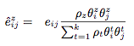
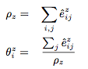
Expectation-Maximization
E-step: estimate the expected number of links in each topic z between w_{i}, w_{j}
M-step: estimate the parameters
ρ_{z} = total number of topic-z links
θ_{i}^{z} = fraction of topic-z links incident to w_{i}
Notes:
the ratio of eˆij to eij is proportional to its Poisson parameter ρz θiz θjz .
θiz is the ratio of the total number of links in topic z where one end node is wi and ρz, which is the sum of the total expected number of links in topic z.
zz

Slide 54
Topical Phrase Generation
learning
support vector machines
reinforcement learning
feature selection
conditional random fields
classification
decision trees
After the topic discovery step:
Mine frequent topical phrases in each topic
Rank the mixed-length phrases

Slide 55
Methods for Comparison
Method | Topic discovery | Phrase mining | Phrase ranking
SpecClus | Hierarchical spectral clustering | Frequent pattern mining | Distance from cluster center
hPAM | Hierarchical Pachinko Allocation Model | No phrase. Only single terms | Word distribution
hPAM_{rr} | Hierarchical Pachinko Allocation Model | No phrase. Only single terms | Reranked with our ranking function
CATHY_{cp} | Our recursive term co-occurrence network clustering method | Frequent pattern mining + topical frequency estimate | Only coverage and purity.
CATHY | Our recursive term co-occurrence network clustering method | Frequent pattern mining + topical frequency estimate | Full ranking function with all factors.

Slide 56
DBLP (Information Retrieval)
ROOT
CATHY

Slide 57
DBLP (Information Retrieval)
ROOT
hPAM

Slide 58
DBLP (Information Retrieval)
ROOT
SpecClus

Slide 59
Phrase & Topic Intrusion Study
User study: 9 CS grad students, two tasks, DBLP dataset
Topic Intrusion task: which child topic does not belong to given parent topic?
Phrase Intrusion task: which phrase does not belong with the others?

Slide 60
Phrase & Topic Intrusion Results
Topic Intrusion: CATHY > CATHYcp >> others
phraseness and completeness criteria help with parent-child relationship
Phrase Intrusion: CATHY ≈ CATHYcp >> others
Notes:
Topic: CATHY does slightly better than CATHYcp in the 3 level hierarchy, and is significantly better in the 4 level hierarchy, suggesting that participants found the phraseness and completeness crite- ria to be helpful.
SpecClus slightly outperforms hPAM, because hPAM generates broad unigrams with good cov- erage, which makes the parent-child relationships difficult to identify, while SpecClus yields phrases with better purity which, when considered jointly, represent a topic more successfully.
Participants answered more questions generated by the hPAM variations than by SpecClus, which, combined with the resulting accuracies, suggests that hPAM generated the least well-separated hierarchy (even with reranking).
Phrase: CATHY and CATHYcp outperform others. As hPAM favors high coverage phrases which are often topic-ambiguous, it posted a low performance. hPAMrr considers phrase purity as well as topical coverage, and therefore performs much better on this task. SpecClus favors purity, and thus is more likely to generate seemingly unrelated high ranked phrases in the same topic, which is reflected here by its poor performance. Once again, participants were more likely to answer ques- tions generated by the CATHY variations than by any of the other three methods.

Slide 61
Topical Hierarchy from DBLP
Venue
Terms
Paper
Authors

Slide 62
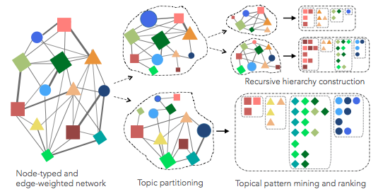
CATHYHIN Framework
Notes:
I’m not getting into this too much right now. The generative model is altered, to account for the different types of nodes and links. Mining and ranking are nearly identical.
There is also a component of learning the link type weights, this slightly improves results

Slide 63
Experiments
Dataset
DBLP: Artificial Intelligence, Databases, Data Mining, Information Retrieval, Machine Learning, and Natural Language Processing
NEWS: Bill Clinton, Boston Marathon, Earthquake, Egypt, Gaza, Iran, Israel, Joe Biden, Microsoft, Mitt Romney, Nuclear power, Steve Jobs, Sudan, Syria, Unemployment, US Crime.
Evaluation 1: Human judged hierarchy quality
Phrase & Topic intrusion detection
Evaluation 2: Efficacy of subtopic discovery
In topic model: Pointwise mutual information between top ranked words of each topic
PMI = 0, independent; >0, positively correlated, <0, negatively correlated
Extend to multi-typed topics: Heterogeneous PMI (HPMI)
Notes:
We performed experiments on two datasets. We collect a subset of computer science papers in 6 areas related to data mining, and news articles from Google news in 16 hot topics. In DBLP, we construct the network with paper titles, authors and venues. In the news dataset, we used news titles, persons and locations to construct the heterogeneous network. The persons and locations are extracted from news text using NLP tools.
We evaluate two aspects of our method. One is about the topic modeling part only – that is the step 1 of our framework. And the other aspect is about the quality of the whole hierarchy, which is the final output.

Slide 64
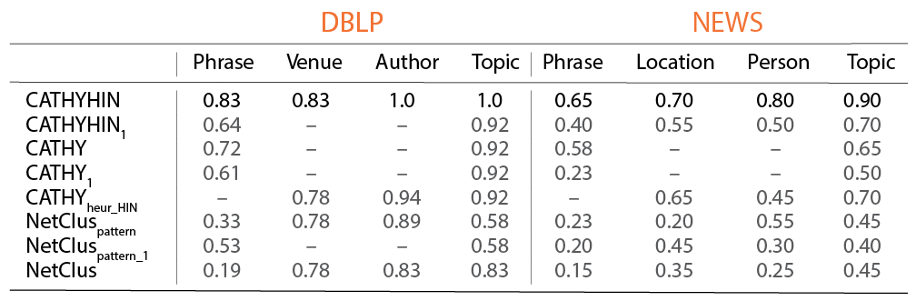
Phrase & Topic Intrusion, like CATHY
Utilizing entity link information is helpful for improving topical hierarchy quality: CATHYHIN >CATHY
CATHY_{heuristic_HIN} cannot assure entities to fit well into the hierarchy constructed only from text
NetClus_{pattern} mixes topics, so the pattern representation do little to improve the topic interpretability
Notes:
The topic intrusion test results show the performance of different methods.
CATHYHIN is our algorithm, CATHY is our previous algorithm that only uses text for topic hierarchy construction. NetClus refers to the method we extend to based on original NetClus.
For all algorithms, the performance on DBLP is better than on NEWS, because DBLP has cleaner structure, and NEWS has more noise due to the imperfection of entity extraction.
In both datasets, CATHYHIN outperforms CATHY, which outperforms NetClus. This shows that utilizing entity link information in a good way is helpful for improving the quality of the hierarchy.
CATHY_heuristic_HIN means that we first run CATHY, and then embed the entities into the textual hierarchy. This heuristic method cannot assure entities to fit well into the hierarchy. For example, in this subtopic related to Egypt news, it puts in US, Sudan, Iran and Washington as locations, which blurs the parent-child relation. So it’s not as good as CATHYHIN.
All the methods with a subscript 1 use single objects instead of patterns of mixed lengths. Patterns help CATHYHIN and CATHY, but not NetClus, because NetClus does not separate topics very well.

Slide 65
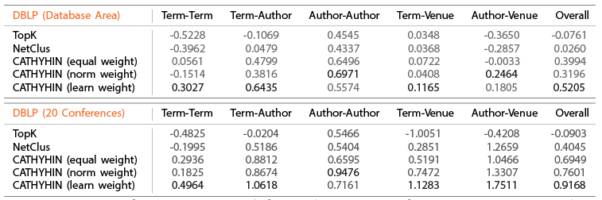
Efficacy of subtopic discovery
CATHYHIN > NetClus even without weight learning (2 to 5 times gain over TopK)
Learned weight is best in overall HPMI
Optimal weight depends on link density, granularity of the topics, and the specific domain
Notes:
Here we just show one table for different subsets in the DBLP dataset. We test the performance for a small topic only about database, and a bigger topic about all areas related to data mining. We compare NetClus and several variations of CATHYHIN. Equal weight is the basic model, norm weight uses a heuristic way to normalize the link weight according to link density, and learn weight is our most advanced model with the ability to learn the weight of different types.
We can find that even the basic CATHYHIN model outperforms NetClus greatly, especially in the smaller topic. It shows the advantage of our unified generative model. Learnt weight is the best in overall HPMI. The optimal weight depends on not only link density, but also the granularity of the topics and the specific domain. So we really need the learning method in general cases to get the optimal performance.
The same conclusion for news dataset.

Slide 66
Data
network data with
short text component
and other entites
Topic Discovery
clustering
co-occurrence network
Topical Phrase Construction
estimated topical frequency and integrated ranking
Evaluation
topical phrase
qualty and subtopic discovery

Slide 67
Constructing Topical Phrases
Data
collection of short texts in scientific domain
Topic Discovery
unigram-generating
topic model (bLDA)
Topical Phrase Construction
frequent pattern mining and integrated ranking
Evaluation
topical phrase
qualty

Slide 68
New Domain New Dataset New Evaluation
Data
collection of longer texts in general domain
Topic Discovery
unigram-generating
topic model (LLDA)
Topical Phrase Construction
frequent pattern mining and integrated ranking
Evaluation
topical phrase qualty and classification task sucess

Slide 69
Constructing
A Topical Hierarchy
Data
network data with
short text component
and other entites
Topic Discovery
clustering
co-occurrence network
Topical Phrase Construction
estimated topical frequency and integrated ranking
Evaluation
topical hierarchy
quality and subtopic discovery

Slide 70
IBM Research Text Analytics Team
After graduation, I will be joining

Slide 71
Thank you!

Slide 72
Appendix

Slide 73
CATHY for Entity Role Discovery
Heterogeneous Information Network
Construct Term Co-occurrence Network from Text Component
Detect Hierarchical Topical Communities
CATHY
Two Types of Entity Role Discovery
Ranking Entities in a Topical Community
Representing an Entity’s Role in a Topical Community

Slide 74
Hierarchical Topical Communities
People and communities are often characterized by the topics and themes they are working on, or communicating about.
We are often interested in analyzing such roles at different levels of granularity
In the real world, topical communities - communities built around shared topics - are naturally hierarchical
People participate in large communities, encompassing many interests
Also participate in small, focused subcommunities
The hierarchical structure of the topical communities allows us to distinguish between, e.g., authors who publish on a diverse range of database topics, and authors who are particular experts in query processing.

Slide 75
Two Types of (Topical) Role Discovery
We present two entity roles that may be discovered
Ongoing example and results from a topical community hierarchy constructed from the DBLP dataset
First, given a topical community and an entity type, which entities play the most important roles in the community?
For example, an author’s contribution to the topics of a community (by way of published papers) represents the author’s role in that community.
Second, for a given topical community and specific entity, what is that entity’s role in the community?
For instance, which topics within the community get published in a particular conference? Or, which specific topics within the community does an author contribute to?

Slide 76
Mining Topical Phrases
Again, frequent pattern mining (item = word)
Estimate topical frequency f_{z}(P)
Phrase | ML | DB | DM | AI | IR | Total
support vector machines | 85 | 0 | 0 | 0 | 0 | 85
query processing | 0 | 212 | 27 | 1 | 12 | 252
world wide | 0 | 7 | 1 | 0 | 26 | 34
social networks | 39 | 1 | 31 | 4 | 33 | 108

Slide 77
Phrase topical frequency
Assumptions:
For a topic-z phrase of length n {w_{x1},...,w_{xn}}, each of the n words is generated from the distribution θ_{z}
The total number of topic-z phrases of length n is proportional to ρ_{z} (total number of topic-z links)
Notes:
denominator is over all of z’s siblings
rho_z

Slide 78
Topical phrase ranking
Topical phrase quality factors:
Coverage (how much of the topic does the phrase cover?)
Purity (does the phrase cover only this topic, and not related topics?)
Phraseness (is it a legitimate phrase rather than a set of words which are frequent in the topic?)
Completeness (is the phrase a fraction of a longer phrase?)
Again, quantify these factors by using the estimated topical frequency of each phrase

Slide 79
Topical phrase ranking function
completeness
coverage
purity
phraseness
Notes:
product of coverage and purity is equal to the pointwise KL-divergence between the probability of et(p) and et,t∗ (p).
product of coverage and phraseness is pointwise KL-divergence between the probability of et(p) under different independence assumptions
Pointwise KL-divergence is a distance measure between two probabilities that takes the abso lute probability into consideration, and is more robust than pointwise mutual information when the relative difference between probabilities need to be supported by sufficiently high absolute probability.

Slide 80
Experiments
DBLP Dataset: paper titles on the topics of Artificial Intelligence, Databases, Data Mining, Information Retrieval, Machine Learning, and Natural Language Processing.
Titles are minimally preprocessed by removing stopwords

Slide 81
CATHYHIN
Constructing A Topical HierarchY
in a Hetergeneous Information Network

Slide 82
Application: Extending to the heterogeneous aspects of the network
Entity Role Discovery in Hierarchical Topical Communities

Slide 83
Document collection (long text)
Document collection (short text)
Network data (text component)
Topic Discovery unigram-generating
topic models
Topic Discovery
clustering co-occurrence network
(term)
Phrase Mining
frequent pattern mining
Phrase Mining
estimated topical frequency
Phrase Ranking
integrated ranking function
Entity Topical
Role Mining
Flat topics
(phrases)
Topical hierarchy
(phrases)
Topical hierarchy
(phrases & entities)
Entity roles

Slide 84
Entity role discovery
People and communities are often characterized by the topics and themes they are working on, or communicating about.
Such role discovery tasks center around topical communities which may be mined from social or information networks.
Most role discovery aproaches are forms of clustering or ranking, working only with network structure, and do not consider topical context

Slide 85
Ranking Entities in a Topical Community
What is the intuitive interpretation of the role of an entity in a topical community?
An entity’s role may be measured by the size of its contribution to the community
DBLP intution: the role of an author is represented by the papers the author writes on the community’s topics
DBLP intution: the role of a venue is represented by its published papers on the topics in the community

Slide 86
Ranking Entities in a Topical Community
There can be multiple ways to define “important”
Prolific: author contributes many papers to the community
Dedicated: author contributes many papers to the community and few papers to sibling communities
Use metric |D_{E,z}| = the estimate for the number of documents contributed by entity E to topic z

Slide 87
Prolific: ranking on coverage
Ranking entities in a community z by |D_{E,z}| means only taking into account how much of the topic an entity covers:
For example, this entity ranking function can find prolific authors in a community
However, it cannot find authors who are dedicated to contributing to community z rather than to z’s sibling communities
ERank_{Cov} = |D_{E,z}|

Slide 88
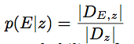
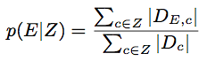
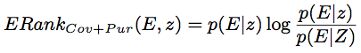
Dedicated : ranking on coverage & purity
Occurrence probability of seeing entity E in community z:
Contrastive probability of seeing E conditioned on mixture of multiple communities Z ⊂Ch^{Parent(z)} (excluding z):
The purity of entity E in z is a ratio of these probabilities
Unifying the coverage and purity criteria:
Notes:
adapt the notion of purity to apply to entites.
We evaluate the purity of entity E in z by comparing the probability of seeing a document E conditioned on community z and the contrastive probability (second equation)

Slide 89
Prolific Authors (ERank_{Cov}) in Data Mining communities
{sensor networks, selectivity estimation, large databases, pattern matching,spatio- temporal moving objects, large collections} | {time series, nearest neighbor, moving objects, time series data, nearest neighbor queries} | {association rules, large scale, mining association rules, privacy preserving, frequent itemsets} | {high dimensional, data streams, data mining, high dimensional data, outlier detection}
divesh srivasta | eamonn j. keogh | jiawei han | philip s. yu
nick koudas | philip s. yu | philip s. yu | jiawei han
jiawei han | christos faloutsos | jian pei | charu c .aggarwal
philip s. yu | hans-peter kriegel | christos faloutsos | jian pei
christos faloutsos | jiawei han | ke wang | christos faloutsos
Notes:
many authors are highly ranked in all communities (e.g. Philip Yu, Jiawei Han, and Christos Faloutsos are top-5 authors in every community).

Slide 90
Prolific Authors (ERank_{Cov}) in Data Mining communities
{sensor networks, selectivity estimation, large databases, pattern matching,spatio- temporal moving objects, large collections} | {time series, nearest neighbor, moving objects, time series data, nearest neighbor queries} | {association rules, large scale, mining association rules, privacy preserving, frequent itemsets} | {high dimensional, data streams, data mining, high dimensional data, outlier detection}
divesh srivasta | eamonn j. keogh | jiawei han | philip s. yu
nick koudas | philip s. yu | philip s. yu | jiawei han
jiawei han | christos faloutsos | jian pei | charu c .aggarwal
philip s. yu | hans-peter kriegel | christos faloutsos | jian pei
christos faloutsos | jiawei han | ke wang | christos faloutsos
Notes:
many authors are highly ranked in all communities (e.g. Philip Yu, Jiawei Han, and Christos Faloutsos are top-5 authors in every community).

Slide 91
Dedicated Authors (ERank_{Cov+Pur}) in Data Mining communities
{sensor networks, selectivity estimation, large databases, pattern matching, spatio- temporal moving objects, large collections} | {time series, nearest neighbor, moving objects, time series data, nearest neighbor queries} | {association rules, large scale, mining association rules, privacy preserving, frequent itemsets} | {high dimensional, data streams, data mining, high dimensional data, outlier detection}
divesh srivasta | eamonn j. keogh | jiawei han | charu c. aggarwal
surat chaudhuri | jessica lin | ke wang | graham cormode
nick koudas | michail vlachos | xifeng yan | s. muthukrishnan
jeffrey f. naughton | michael j. passani | bing liu | philip s. yu
yannis papakonstantinou | matthias renz | mohammed j. zaki | xiaolei li
Notes:
only those authors who are significantly more
dedicated to one community are highly ranked, resulting in no overlap between communities. Some prolific authors, such as Christos Faloutsos, are no longer highly ranked anywhere, because their contributions are fairly equal among the communities.

Slide 92
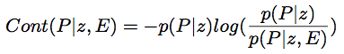
Entity’s Role in a Topical Community
Goal: to highlight the subset of the community which illustrates the specific contribution of the entity
For example, which data mining topics does Philip Yu work on? What about Christos Faloutsos?
Introduce a new phrase ranking function, based on entity community contribution:
Information Theoretic interpretation: the pointwise KL-divergence between the likelihood of seeing phrase P in the documents in community z, and the likelihood of seeing phrase P specifically in the documents linked to entity E, in z.
Notes:
The general phrase ranking function used to rank phrases in topical hierarchy can’t be specific to entities
f_{z,DE} (p) represents the frequency of phrase P in community z for the document subset D_{E}.
Cont(P|z,E) has a nice information theoretic interpretation as the pointwise Kullback-Leibler (KL) divergence between the likelihood of seeing phrase P in the documents in community z, and the likelihood of seeing phrase P specifically in the documents linked to entity E, in z. Pointwise KL divergence is a distance measure between two probabilities. Therefore, Cont(P |z, E) upranks P if its frequency in the community in conjunction with the entity E is higher than would be expected, based on its overall topical community frequency.

Slide 93
Entity’s Role in a Topical Community
Using only the Contribution ranking may not be ideal
Define a Combined ranking function for a phrase P
Incorporates both the relationship between the entity E and the topical phrase, as well as phrase quality (CATHY ranking function):
Entity Contribution
Topica Phrase Quality
α∈ [0,1] (we empirically setα=0.5 for this dataset)

Slide 94
Two Entity Roles in Data Mining
Philip S. Yu
Christos Faloutsos
Notes:
We also show the entity frequency for each community EF_{z}(E) which represents the estimate for the number of papers written by that author in the community.
It so happens that our dataset contains more papers written by Philip Yu than by Christos Faloutsos, and so the entity topical community frequencies are higher for Philip Yu.

Slide 95
Top authors in a database subcommunity
{query processing / query optimization / deductive databases / materialized views / microsoft sql server / relational databases}
elke a. rudensteiner | query processing / query optimization / materialized views / stream processing / object-oriented databases
hamish pirahesh | query processing / query optimization / materialized views / relational data / relational xml
surajit chaudhuri | query optimization / relational databases / microsoft sql server / materialized views / relational data
jeffrey f. naughton | materialized views / xml query / query processing / relational xml / maintenance view
per-åke larson | materialized views / microsoft sql server / query optimization / materialized maintenance views / relational data
vivek r. narasaya | microsoft sql server / materialized views / relational databases / query management / sql data
serge abiteboul | materialized views / xml data / schemas / query evaluation / materialized maintenance views
Also shown: Top-ranked phrases for each author
Notes:
Erank cov + purity is used. This is more clearly a useful thing to do on lower levels of the hierarchy

Slide 96
Top authors in a database subcommunity
{concurrency control / database systems / main memory / load shedding / database concurrency control / load balancing}
avi silberschatz | concurrency control / main memory / locking / database systems / transaction management
david b. lomet | recovery / systems recovery / b-trees / transactions recovery / performance access
henry k. korth | concurrency control / database systems / main memory / protocol / transaction systems
bharat k. bhargava | concurrency control / distributed systems / distributed database / recovery / distributed database systems
c. mohan | concurrency control / recovery / locking / data systems / transaction systems
ahmed k. elmagarmid | database systems / concurrency control / distributed database / distributed systems / access control
nancy lynch | concurrency control / locking / nested transactions / control transactions / concurrency transactions
Also shown: Top-ranked phrases for each author
Notes:
Erank cov + purity is used. This is more clearly a useful thing to do on lower levels of the hierarchy

Slide 97
The roles of SIGIR
Notes:
Erank cov + pur is used

Slide 98
The roles of 3 venues in IR
SIGIR | WWW | ECML
information retrieval | web search | word sense disambiguation
question answering | semantic web | world wide web
web search | search engine | information extraction
natural language | question answering | semantic role labeling
document retrieval | web pages | knowledge discovery
relevance feedback | world wide web | query expansion
query expansion | web services | machine translation
The flavor of each venue regarding which Information Retrieval problems are of interest to each one.
Notes:
By examining the roles of different venues within a single community, we can also gain some insight to the flavor of each venue. As an example, Table 5 compares the roles of three venues - SIGIR, WWW, and ECML - in the general IR community. While both SIGIR and WWW are usually char- acterized as IR venues, we can clearly see that SIGIR plays a more broad role, publishing most of the topics present in the community, whereas WWW focuses only on those topics that are directly related to the web. On the other hand, ECML is considered to be an ML venue, and its contribution to the IR community is the publishing of papers on topics that use machine learning techniques. Note that all three venues share some high-ranked phrases, illustrating how the roles of all three venues overlap in this community. If we were to strictly label venues, and therefore the papers they publish, as belonging exclusively to one or another commu- nity, we would not be able to discover these interesting roles.

Slide 99
Proposed Work

Slide 100
Document collection (long text)
Document collection (short text)
Network data (text component)
Topic Discovery unigram-generating
topic models
Topic Discovery
clustering co-occurrence network
(term or heterogeneous)
Phrase Mining
frequent pattern mining
Phrase Mining
estimated topical frequency
Phrase Ranking
integrated ranking function
Entity Topical
Role Mining
Flat topics
(phrases)
Topical hierarchy
(phrases)
Topical hierarchy
(phrases & entities)
Entity roles

Slide 101
Document collection (long text)
Document collection (short text)
Network data (text component)
Topic Discovery unigram-generating
topic models
Topic Discovery
clustering co-occurrence network
(heterogeneous)
Phrase Mining
frequent pattern mining
Phrase Mining
estimated topical frequency
Phrase Ranking
integrated ranking function
Entity Topical
Role Mining
Flat topics
(phrases)
Topical hierarchy
(phrases)
Topical hierarchy
(phrases & entities)
Entity roles

Slide 102
Document Collections: longer texts, broader variety
Currently, effective when the documents in question are short and reasonably well formed (e.g. bibliographic data)
Preliminary results suggest performance on longer documents is also good, and this is currently being formally studied.
Can the current approach can be enhanced for longer documents with techniques from topic modeling or NLP while still keeping the approach efficient?
Also propose to work with several different document collections in order to be able to claim robustness.
eg: news networks, product reviews, business descriptions, or bioinformatic data.
We believe a quality submission may be made ready by the middle-to-late part of Spring 2014 semester, when several appropriate venues such as ECML and ICDM have submission deadlines.

Slide 103
Entity Role Mining
Preliminary results use a sequence of CATHY and a reasonable heuristic from the original link information
Next step: formalize and improve on these results using CATHYHIN
allows to incorporate the heterogeneous network links in the topical community discovery step – some initial steps exist via CATHYHIN paper
Very likely to get good results, given the performance of CATHYHIN against CATHY
this next step is a natural extension given the existing work.
Propose to complete a project that would explicitly compare the performance of CATHYHIN to CATHY and the network links (as described in this chapter), as well as other existing approaches for entity (topical) role mining.
A formal evaluation would result in a convincing argument for the applicability of doing a human-centric analysis of topics.
We believe a quality submission may be made ready by the early-to-middle part of Spring 2014 semester, when several appropriate venues such as KDD and ASONAM have submission deadlines.

Slide 104
three major problems with topic representation
problem 1 (solve by KERT)
constructing topical phrases, not unigrams
problem 2 – robustness and flexibility and real-world applications
existing approaches sometimes work on one type of document but not another, and also there is no interest in evaluations based on tasks that human beings have to perform
problem 3 (solve by CATHYs)
constructing topical hierarchy from network data, and what you can do with that

Slide 105
animated flow thing
overall thing is finding latent topical phrases
Kert
Kert long
Cathy’s
then return back to KERT

Slide 106
CATHY output is… involved
How do we interact with a hierarchy of this?
And it only gets worse when working with a heterogeneous information source

Slide 107
AMETHYST
Analyzing, Mining, and Exploring a Topical HierarchY SysTem

Slide 108
User Study – nKQM metric
nKQM = normalized keyphrase quality measure for top-K phrases
t = number of topics
Mt,j = jth keyphrase generated by method M for topic t.
score_{aw} = agreement-weighted average score for the Mt,j keyphrase
mean of the judges’ score multiplied by the weighted Cohen’s κ.
This gives a higher value to a keyphrase with scores of (3,3,3) than to one with scores of (1,3,5), though the average score is identical.
IdealScore_{K} is calculated using the scores of the top K keyphrases out of all judged keyphrases.
Notes:
This is very much like nDCG (normalized discounted cumulative gain)

Slide 109
Books with multiple labels
History
Religion
correct vs incorrect | History Philosophy Religion
kert | 2.96 > 2.28 §§
pdlda | 2.15 ≈ 2.11
turbotopics | 3.19 ≈ 3.27
785
12
102
6
25
29
272
Philosophy
Wilcoxon rank sum §§ p < 0.0001
Evaluate 5 books from each of the intersections
history & religion, history & philosophy, religion & philosophy
This time, want e.g. mean (history, religion) > mean (philosophy) for a book labeled as both history & religion
Notes:
move to appendix

Slide 110
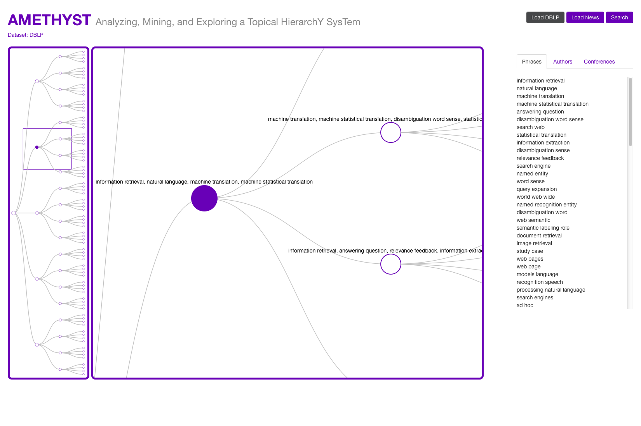
Browsing the DBLP topical hierarchy
Structure View shows the entire topical hierarchy.
The node representing the Information Retrieval topic is selected in Zoom View.
The Detail View on the right shows the top ranked phrases for this topic.

Slide 111
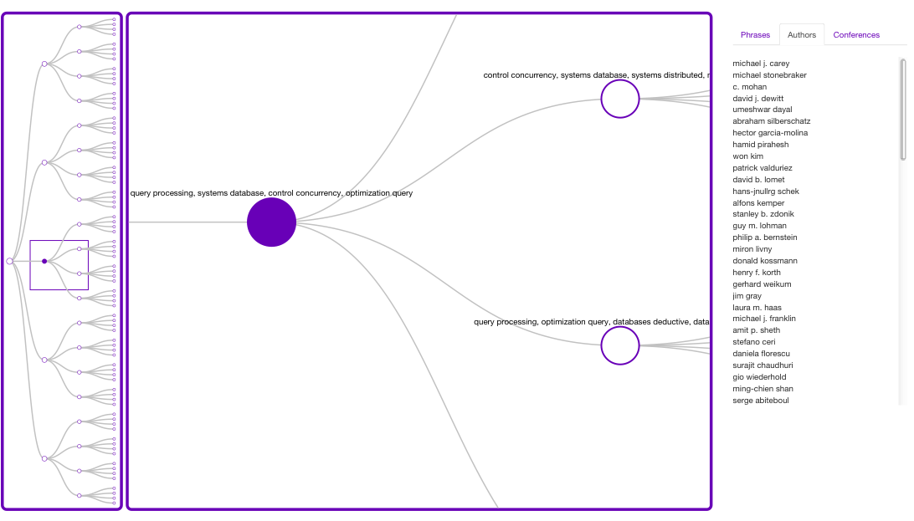
Browsing the DBLP topical hierarchy
Structure View shows the entire topical hierarchy.
The node representing the Database topic is selected in Zoom View.
The Detail View on the right shows the top ranked authors for this topic.

Slide 112
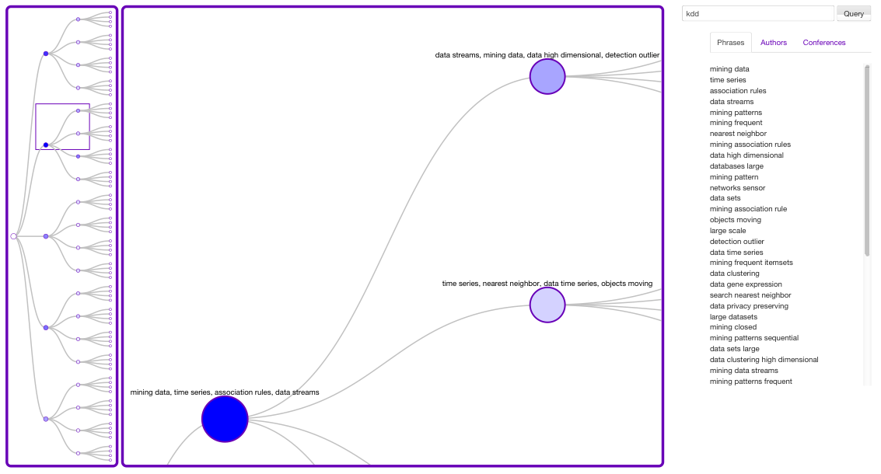
Searching the DBLP topical hierarchy with query=‘kdd’
The Structure View uses color to show the relative importance of each topic with respect to the queried entity.
The node representing the Data Mining topic is selected in Zoom View.
Detail View shows the top ranked phrases for the queried entity in this topic.

Slide 113
Related work I
Ontology, taxonomy, hierarchy
We do not use extra knowledge other than given text
Category | Node represents | Edge represents | Recursive construction?
Ontology learning | A concept (a phrase, or several synonym phrases) | Is-a relationship | No. All concepts are extracted first, then relationship
Hierarchical topic modeling (hLDA, PAM, hPAM) | A topic (distribution over words) | Generative edge (probabilistic dependency) | No. All topics are inferred at once
Taxonomy construction | A category (cluster of concepts) | Containment relationship | Yes if the clustering is performed top-down
Document categorization | A category (cluster of documents) | Containment relationship | Yes if the clustering is performed top-down
CATHY | A topic (ranked list of phrases) | Containment relationship | Yes. Phrases are mined after topics are found
Notes:
When

Slide 114
Related work II
Topical phrase extraction and ranking
Category | Work with topic hierarchy? | Bias of phrase length? | Cost
Ngram topic modeling (Wang ‘07, Lindsey ‘12) | No | Yes | High
Language model (Tomokiyo ‘03) | Yes, based upon foreground and background corpus | Yes | Low
Statistical test (Turbo topic) | Yes, based upon topic-tailored corpus | Yes | High
Graph-based ranking (Zhao ‘11) | Yes, based upon topic-tailored corpus | Yes | Low
Topic labeling (Mei ‘07) | Yes, based upon conditional word distribution | No | High
CATHY | Yes, no additional input is needed | No | Low
Notes:
When

Slide 115
Related work III - CATHYHIN
Multiple types of linked entities improve the quality of topic discovery
Entity-topic model (Kim et al. ICDM ‘12)
cFTM (Chen et al. KDD ‘12)
TMBP-Regu (Deng et al. KDD ‘11)
iTopicmodel (Sun et al. ICDM ‘09)
NetClus (Sun et al. KDD ‘09)
The only one that generates multi-typed topic
Term
Author
Venue
Term
Author
Venue
……
data /
database /
queries /
system /
query
divesh srivastava / jeffrey f. naughton / christos faloutsos / raghu ramakrishnan / surajit chaudhuri
SIGMOD/
ICDE /
VLDB /
PODS /
CIKM /
model/ retrieval / learning / information / text
w. bruce croft / chengxiang zhai / james allan / maarten de rijke /
c. lee giles
SIGIR/
ACL /
CIKM/
IJCAI/
AAAI
Notes:
The second point, is sort of proved by some related work already. For example, the entity-topic model by Kim’s ICDM paper last year. They don’t work with hierarchy. They work with flat topics. They mainly address the second issue by using the entities to help the topic modeling. Only the last piece of work, NetClus, also addressed the first issue about the topic representation. It is the only one to generate multi-typed topics. Also, NetClus can be easily extended to generate a topic hierarchy. So our work is closely relevant to NetClus.

Slide 116
some other topic models
HDP – hierarchical Dirichlet (Teh, Jordan, Blei ‘06)
mixed membership model
assumes that a frequent topic will on average occur frequently within each document (not always the case in document collection) (across-data prevalence is correlated to within-data prevalence)
Focused topic model (Williamson, Blei ICML’10)
alternative to HDP
reduces aforementioned correlation – places binary weights on topics within a document, so only some topics are used within each document

Slide 117
some topic models with entities
ATM - Author-topic model (KDD’04)
topic distributions are tied to authors
contextual FTM (Chen KDD’06)
extends ATM, also considers venue information
entities are an additional source when choosing document topic
Entity topic model (ETM) (Kim ICDM’12)
entity information informs topic choice
also model correlation of entity term distributions and topic term distributions
Group-Topic model (McCallum ‘07)
attributes of relations are words, latent variable represents the topic responsible for generating those words.
Notes:
everyone does terms, not phrases, lots of it is some kind of extensions of LDA
point is, word is generated based on both a term distribution, and entity distribution

Slide 118
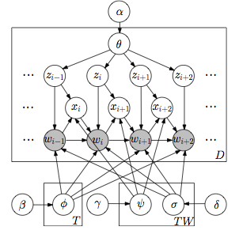
TNG model
generates unigrams or bigrams in order
for each word, first sample a topic
then sample its status as a unigram or bigram
finally sample the unigram (bigram) from a topic-specific unigram (bigram) distribution

Slide 119
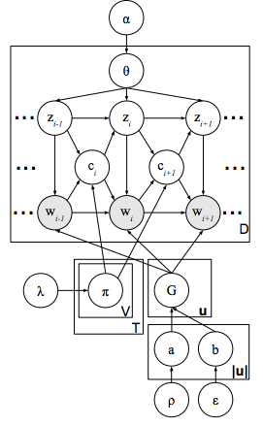
PDLDA model
Similar to TNG, though each phrase explicitly forced to belong to a single topic
word distributions modeled as HPYP (Dirichlet + discount parameter), fits a bit better

Slide 120
CATHY on noisier data: news article titles
Japan tsunami
nuclear plant meltdown
benefits (concerts) to raise relief money
responses (Red Cross) to victims of tsunami / earthquake
Egyptian revolution
economy concerns

Slide 121
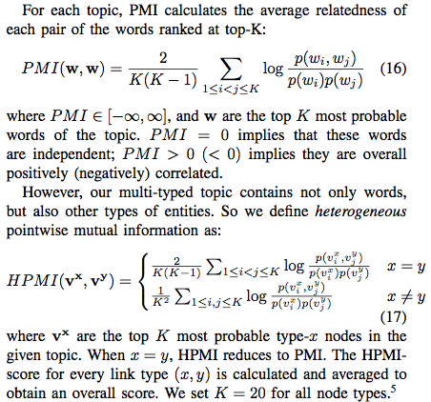
HPMI

Slide 122
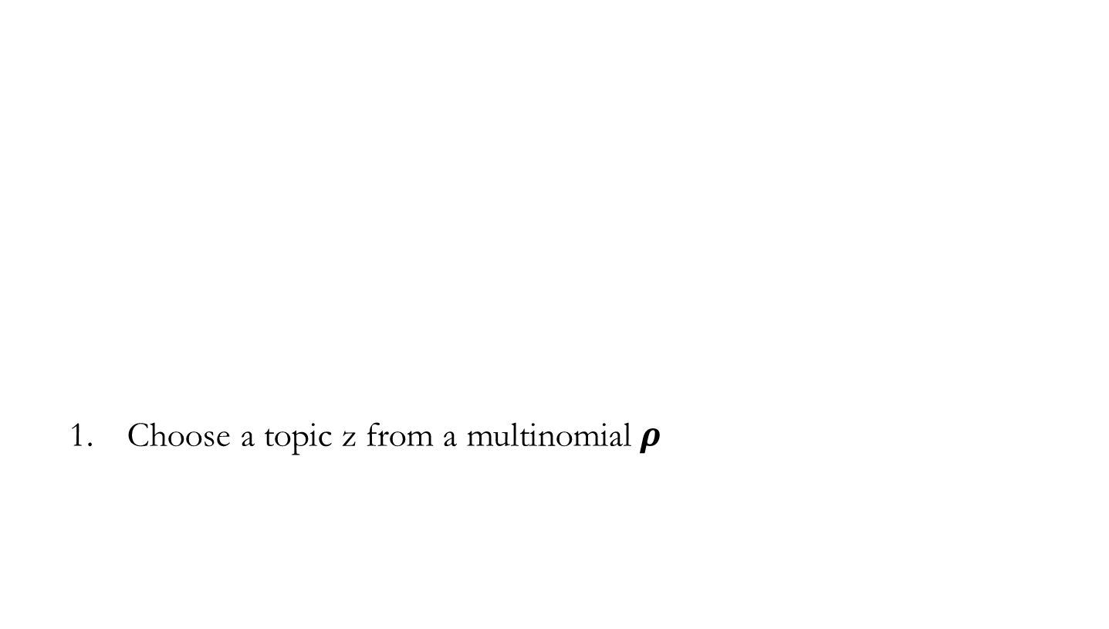
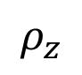
CATHYHIN: Generative assumption
z=1 (Database)
Choose a topic z from a multinomial $ρ$
$$ρ_{z}$$
0: 0.05
1: 0.3
2: 0.35
3: 0.3
 | Topic of the link
 | Type of 1st node
 | Type of 2nd node
 | First end node
 | Second end node
Notes:
Based on that intuition, we have this generative model. We generate each single link in the network by the following process. First, we randomly draw a topic z from a multinomial distribution \rho. This is the overall proportion of each topic. In this example, we chose topic 1 with the probability 0.3
How to do random sampling? Phi and link inference; phi

Slide 123
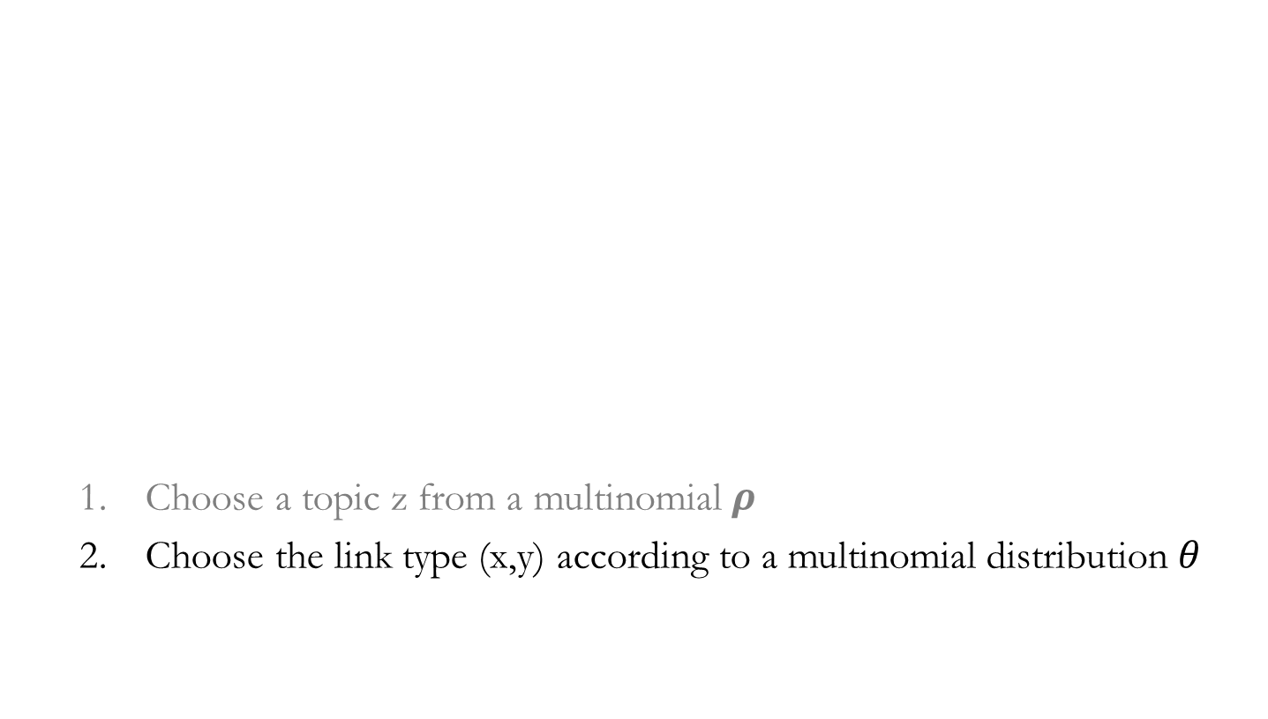
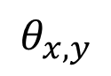
CATHYHIN: Generative assumption
z=1: Database,
(x, y)=(term, term)
Choose a topic z from a multinomial $ρ$
Choose the link type (x,y) according to a multinomial distribution $θ$
$$θ_{x,y}$$
(term, term): 0.25
(term, author): 0.15
(author, author): 0.1
…
Notes:
Next, we randomly draw the link type from another multinomial \theta. The link type is the type of the two nodes of a link x and y, like term-term, term-author, author-author. We chose (term,term) with the probability 0.25

Slide 124
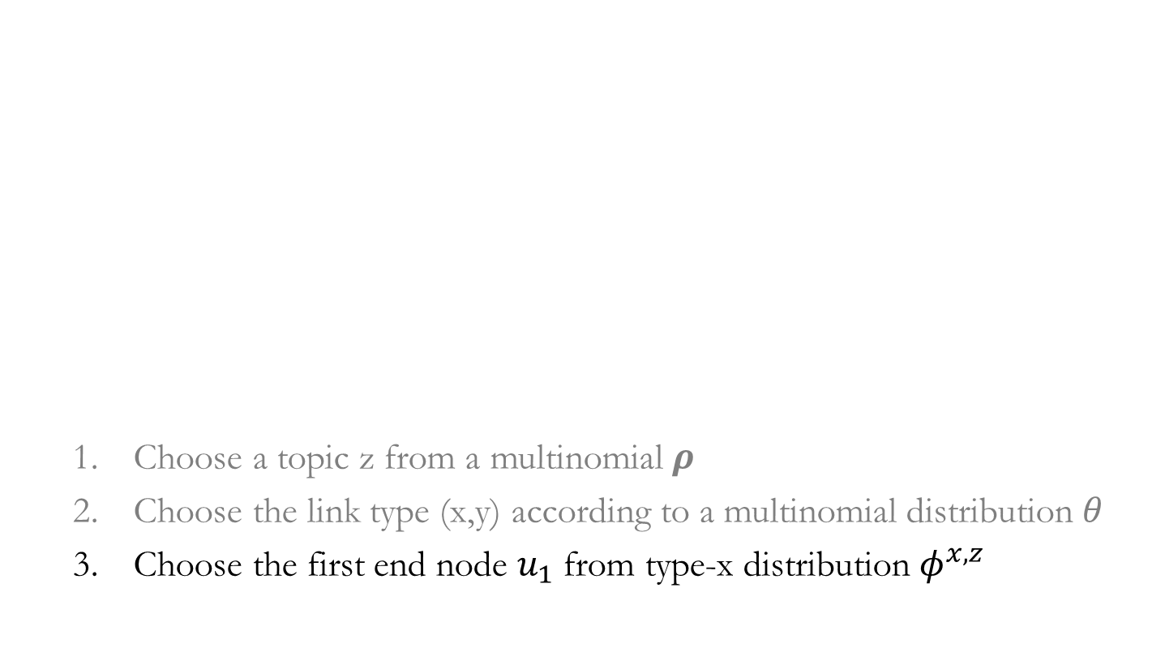
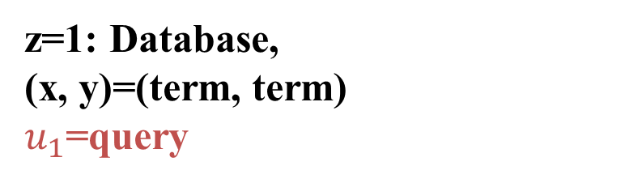
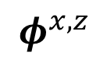
CATHYHIN: Generative assumption
z=1: Database,
(x, y)=(term, term)
$u_{1}$=query
Choose a topic z from a multinomial $ρ$
Choose the link type (x,y) according to a multinomial distribution $θ$
Choose the first end node $u_{1}$ from type-x distribution $φ^{x,z}$
$$φ^{x,z}$$
Query:0.05
Database:0.1
…
Notes:
The we draw the first node of this link from the node distribution of its type. Now the type x is term, so we use the term distribution, and we chose the word query with probability 0.05

Slide 125
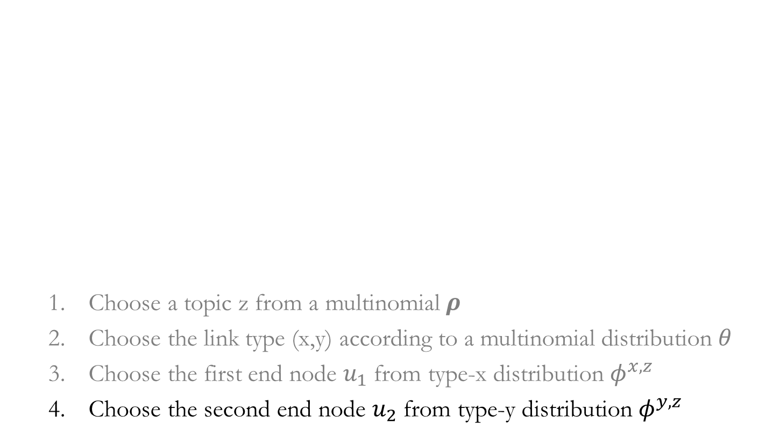
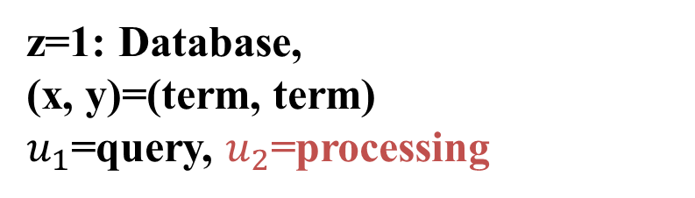
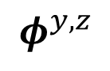
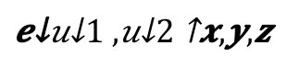
CATHYHIN: Generative assumption
z=1: Database,
(x, y)=(term, term)
$u_{1}$=query, $u_{2}$=processing
Choose a topic z from a multinomial
Choose the link type (x,y) according to a multinomial distribution
Choose the first end node from type-x distribution
Choose the second end node from type-y distribution
$$φ^{y,z}$$
Query
Processing:0.002
Optimization:0.001
…
Notes:
Finally, we chose the 2nd node of this link, also from the node distribution of its type. Now the type is again term, so we still use the term distribution, and chose processing with certain probability. Now we generate a term-term link in topic 1, between query and processing. It means that we will increment the count of topic-1 links between query and processing by 1.
Make efficiency: 10 edges: together, generate one number
And we repeat this process again and again and again, until we generate all the links.
Hidden parameters. E: observed links. Posson distribution. Links inferred to predict the maximum likelihood of parameters.
60 40 (observed ) -> optimize sum=1 number of edges -> number of iterations; 10-10
EM ALGORITHM

Slide 126
Collapsed generative process
What we observe is the link weight (the number of unit-weight links) between any two nodes
Notes:
That process is very intuitive. But eventually, what we observe from the data is the total number of links between any two nodes in topic t. All the other parameters and variables must be estimated from this observation. If the link weight is 100 between two nodes, we have to sample 100 times. To make our inference more efficient, we derive a collapsed generative process, which can directly generate link weight between any two nodes just once, instead of, like 100 times. The collapsed generation of link weight follows a Poisson distribution. We use this distribution, write down the log likelihood, and design an E-M algorithm to infer the node distributions and the partitions of links.
Prior knowledge and random sampling?

